Slide 1
Roxton Village Neighbourhood Plan:
Get involved!
What is happening?
What is a neighbourhood plan?
Who is involved?
How long will it take?
What does this have to do with me?
What do I have to do?
Why do we need a Neighbourhood Plan?

Slide 2
What is a Neighbourhood Plan?
A neighbourhood plan is a way for communities to have a say in the future of the places where they live and work. It helps YOU to:
choose where you want new homes, shops and offices to be built
have your say on what those new buildings should look like
be more involved in planning permission for the new buildings you want to see go ahead.
It’s basically a ‘to do’ list for the village!
It is an official document that supports and guides local planning (alongside other larger planning policies and legislation).
Why do we need one in Roxton?
to guide future development
There are currently a number of planning issues that will affect the village - EWR, the Black Cat development and A428 extension, not to mention proposals for additional houses and industrial buildings.
One way of stopping development we don’t want (and, of course, getting development that we DO want!) would be if we could refer to our local Neighbourhood Plan. However, without a neighbourhood plan, we have nothing to refer to!
to develop a community-led vision for the future of our village.
We (the Neighbourhood Plan Steering Group) are separate from the Parish Council; we’re your neighbours and residents who want to develop a plan that encompasses what the people of Roxton want and need for their own village.
simply, because we currently don't have one (which makes things a bit difficult!)!
If you would like to help too - contact us today!

Slide 3
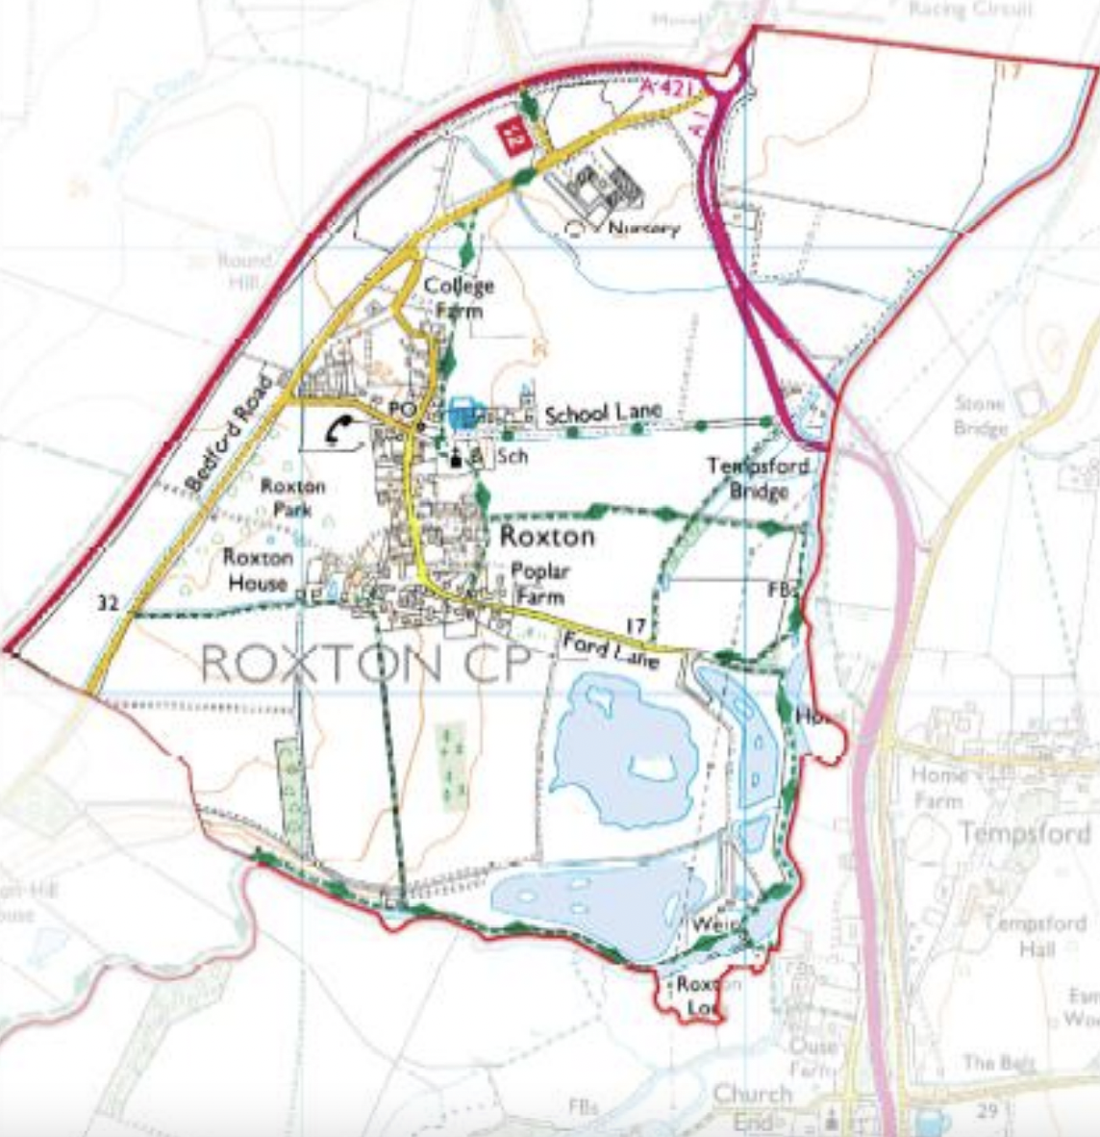
What area does the Neighbourhood Plan cover?
(according to the decision granted by Bedford Council on 29 July 2014, in accordance with Section 61G Town and Country Planning Act 1990, as inserted by the Localism Act 2011 Schedule 9 paragraph 2)
Why should you get involved?
We need a wide range of people, from all across the village, to get involved, even if it’s just to act as an ambassador for your street/ neighbours (e.g. attending a meeting and feeding back what was discussed). If you have a background in planning/ heritage/conservation/ infrastructure/ whatever, then that’s a great bonus, but what we need, more than anything, is for everyone in the village to feel like they’ve contributed and had their say.
If you can spare any time at all, please do let us know.
(Also, we also have cake and biscuits!)

Slide 4
FAQs
Do you need to have any qualifications or experience of planning?
No! No experience necessary. As we said, expertise or knowledge of a particular element of the plan is a bonus, but what we need, more than anything else, is a cross-section of people in the Neighbourhood so that we get the ‘voice’ of the whole area.
How much time do I have to commit?
As little as an hour a month, up to a few hours a month, depending on what you wish to do, or how you wish to help. The more people involved, the less work for everyone!
How long will it take to produce the Neighbourhood Plan?
We are, realistically, looking at a timescale of 2-3 years. However, once we have the Neighbourhood Plan, it will last for many years.
Who else is involved?
The Neighbourhood Plan Steering Group are a group of local residents (main contacts below). During the process of developing the Plan, we will need to consult and consider the views of many different stakeholders - the Parish Council. Local Council, Highways, Environment Agency, Campaign for Rural England, Historic England, nature and wildlife groups, etc. Part of the process will also be to consult and pay for qualified professionals where needed. However, we would really like the Neighbourhood Plan to be driven by us - the residents!
If I don’t get involved with the Neighbourhood Plan Steering Group, how can I have my say?
There will be a consultation process throughout - definitely a survey/ questionnaire and public meetings to discuss ideas and the draft plan, for instance. However, we’d rather everyone gets involved to have your say from the start. So CONTACT US!
Contact Details
Julian Chillingworth: chillingworthj@aol.com 07803906815
Claire Rose: clairecamrose@gmail.com 07931221239
Sue Holland mysty.sh75@gmail.com

