Slide 1
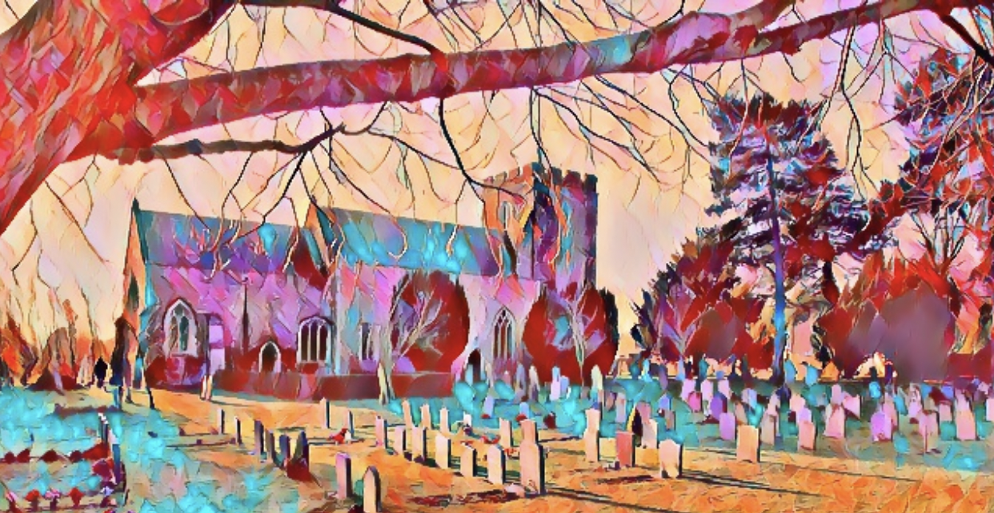
Roxton
Neighbourhood Plan
Consultation Launch Event
Friday 17th November (5-7 pm)
and
Sunday 19th November (3-5 pm)
at
Roxton Village Hall

Slide 2
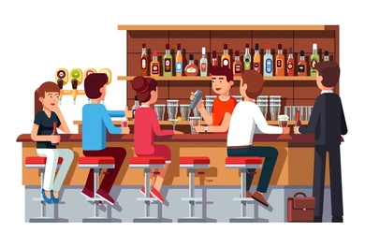
You’re invited to the launch of Roxton’s Neighbourhood Plan consultation process at the Village Hall on Friday 17th and Sunday 19th November!
Of course, this won’t be the only way you’ll get to express your opinion and influence the Neighbourhood Plan process. It’s one of many opportunities we’ll use to collect your important views as members of Roxton parish about what the Plan should include and look like.
The Roxton Neighbourhood Plan Steering Group is made up of parishioners just like you. We’ll be on hand to hear your ideas and to answer any questions you might have about the process.
The bar will be open as usual on both Friday night and Sunday afternoon and for those who prefer a cuppa, free tea, coffee and cake will also be provided! Pop in and join us.
We’ll also be introducing our new website which is one of the ways we’ll capture information as the consultation process develops:
www.roxtonplan.org.uk

Slide 3
Welcome to the Launch Event for the Roxton Neighbourhood Plan.
This is the first step in how the Plan is prepared, giving you all an opportunity to express your views on where you live, what you like about the place, what you want to protect, and what you want to change or improve.
The Plan will be generated by everyone who lives and works here.
Feedback will help define what the parish could look like in 10-15 years’ time. With a robust Neighbourhood Plan, we’ll have a more formal approach when it comes to development (and hopefully avoid the type of conflict we’ve seen recently).
We want to create a real sense of community ownership of the Plan, and this launch event is just the start. You’ll be consulted again as it develops, but we’re launching the Plan website and garnering your initial ideas, thoughts and views of the local community. This leaflet serves two purposes:
To let you know about the event - held on two days to encourage as many of you to attend as possible
To suggest some of the issues/questions you might want to consider
You can use this leaflet to jot down any initial notes or ideas you’d like to discuss at the launch event.
OR
If you can’t come along, you can let us know your thoughts by contacting the Neighbourhood Plan Steering Group directly via the website.

Slide 4
What is a Neighbourhood Plan and what happens next?
The aim of a Neighbourhood Plan is to fully involve people in decisions about their own locality. It’s a formal way for communities to help shape where they live and work, and to help guide the way the local area may change and be protected in the future.
Completed Plans form part of the formal planning framework and must be taken into account when planning applications are decided. But to do so, it has to meet certain ‘basic conditions’. These are to ensure the Plan takes account of Bedford Borough Council’s Local Plan 2030/2040 and National Planning Policy and Guidance, and conforms with Governmental Plan Policies.
The Steering Group will work to ensure these legal requirements are met while promoting your needs, priorities and the visions identified during our consultations. We’ll meet monthly throughout and the timeline for the Plan is:
Autumn 2023
• Launch event at the Village Hall
• Collate initial responses and ideas
• Feedback findings through the Neighbourhood Plan website
Early 2024
• Launch public meetings – February/March
• Local businesses and stakeholders contacted
• Green Infrastructure survey commissioned
• Questionnaires distributed to all residents
• Questionnaires returned & analysed
Summer 2024
• You will have the opportunity to comment on the draft Plan
• We’ll hold Stakeholder meetings

Slide 5
What happens next (continued)
Autumn 2024
• Based on public consultation feedback, we will aim to prepare a draft plan for public comment around the end of 2024. This is an obligatory formal step known as ‘pre-submission’ consultation (Regulation 14).
• Final draft based on feedback and continuing consultations will be prepared for submission to Bedford Borough Council. If all goes according to schedule, this will be achieved in early 2025
Spring 2025
• Bedford Borough Council will carry out their own Plan consultation and check everything necessary has been provided.
• Borough Council publicise the Plan and then arrange an independent examination to check it conforms to all the necessary legal and technical requirements, and make any recommendations
Summer 2025
Before the Plan can come into force, it must get the backing of a majority of residents voting in a local referendum (which is why the more people we speak to, the easier this will be!). Our aim is to have completed the process and hold the local referendum by late 2025.

Slide 6
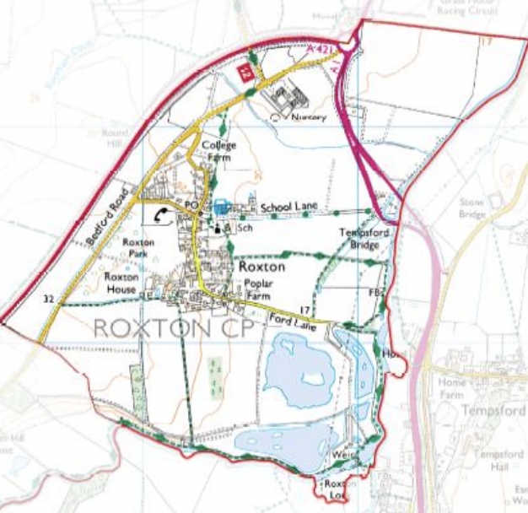
A Start: The Big Issues... ?
We made a start on the key issues, but the Plan is for the whole village, so what do you think?:
East West Rail - the preferred route corridor will cross Roxton parish (Route E) and have major impacts on much of the parish
Traffic and transport in and around Roxton - Black Cat improvements/A421
How to protect Roxton’s rural character - the new ‘employment’ zone near the A1 (‘Policy EMP8 Land at Roxton, south west of the Black Cat roundabout’ in the Local Plan 2040).
The importance of protecting (and promoting) Roxton’s historic environment, in accordance with its Conservation Area designation - Possible future housing developments

Slide 7
Key Questions 1: The Big Issues
We want to know:
Have we got the ‘key Issues’ right?
Are there any other major issues you want considered?
Use this space to write any notes:
……………………………………………………………………
……………………………………………………………………
……………………………………………………………………
……………………………………………………………………
……………………………………………………………………
The Plan covers a range of areas and we’ll be providing you with some background on a range of topics, as well as asking you what you think. The areas are:
Housing
Environment and Green Infrastructure
Heritage and the Historic Environment
Employment and Businesses
Getting About and Transport
Amenities and Facilities
Please feel free to give us your thoughts on
any or all of them.

Slide 8
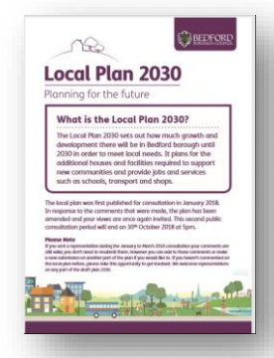
Housing
According to the 2021 Census (ONS), Roxton has a population of 340 people.
The main concentrations of residential properties are along the High Street (both north and south of the crossroads, including, Park Road/Old Bedford Road to the west, School Lane to the East, and along Ford Lane to the south (including cul-de-sacs such as Hills Close, Poplar Close, Saxon Close and Southfields).
At the time of writing, Bedford Borough Council has approved the building of 50 houses to the North of School Lane, behind the north end of the High Street (to the east). This will extend the built-up area of Roxton and increase the total number of houses in the village by nearly a third.
In the rest of the parish, the Borough Council’s Local Plan 2030 and Local Plan 2040 (should) provide the present framework for housing development.
However, currently, there is also a planning application for proposed housing on the plots of land, known informally as ‘Parcel A’ and ‘Parcel B’, to the north of the School Lane development and on the land behind High Street to the west (which are not on the Local Plan 2030 or Local Plan 2040). Known locally as ‘Jiggy’s land’.

Slide 9
Key Questions 2: Housing
We understand housing can be an emotive issue which is why we need to hear the views of as many people as possible on the subject. Current national and local planning policies detect how many new homes should be built. A Neighbourhood Plan can shape the type, the design, the layout etc.
1. Do you think there will be a need for more housing in Roxton parish in the next 10-15 years?
2. If more houses were to be built, how many do you think would be appropriate?
3. If there were more houses, what types do you think should be built? e.g. affordable/starter homes, social housing, retirement/sheltered homes, bungalows, smaller houses (1-2 bed), larger houses/family homes (3+ beds), flats, or a mix of these.
4. If new houses were built, what sort of sites should be considered? e.g. brownfield sites (where there has been development in the past), greenfield sites (e.g. agricultural land), all on a single large site, or small infill developments around the parish.
5. Do you think existing infrastructure or services could support more housing?
6. What else do you think about this topic?
Use this space to write any notes:
……………………………………………………………………
……………………………………………………………………
………………………………………………………………….

Slide 10
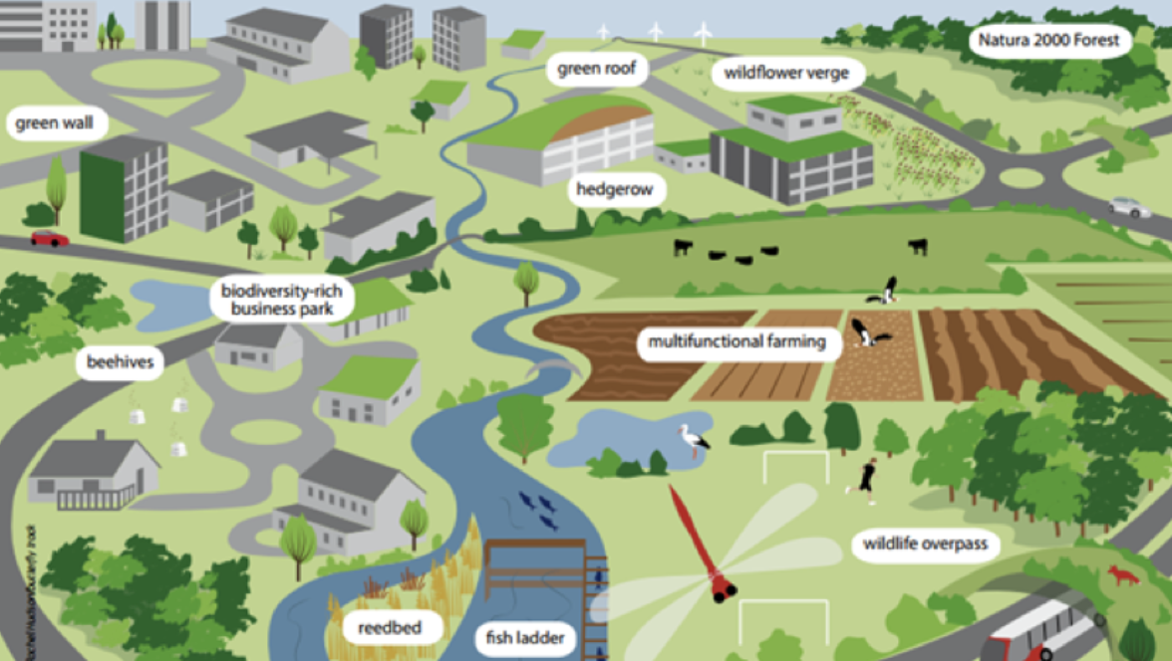
Environment and Green Infrastructure
“Green infrastructure is a network of multi-functional green space and other green features, urban and rural, which can deliver quality of life and environmental benefits for communities.”
(Town and Country Planning Association)
We are going to hold “Green Infrastructure” workshops in the near future (early 2024) to get more detailed thoughts on the local environment. But in the meantime, we would welcome your thoughts on the local environment.
Green infrastructure is not simply an alternative description for conventional open space. It includes parks, open spaces, playing fields, woodlands – and also street trees and street hedgerows, allotments, private gardens, green roofs and walls, sustainable drainage systems (SuDS) and soils. It includes rivers, streams, canals and other water bodies, sometimes called ‘blue infrastructure’.
Trees and hedgerows are one of the best features which make an area feel rural and not suburban.

Slide 11
Key Questions 3: Environment and Green Infrastructure
1. What parts of the local environment do you value most and why?
2. What do you think should be protected or enhanced?
3. How do you think developments should be blended into our village environment?
4. How can we plan for climate change, combining sustainability with protecting our rural heritage?
5. Are there any gaps in the Green Infrastructure network and in what ways can our Neighbourhood Plan help to enhance and create new Green Infrastructure for all residents and visitors?
6. What else do you think about the local environment?
Use this space to write any notes:
……………………………………………………………………
……………………………………………………………………
……………………………………………………………………
……………………………………………………………………
……………………………………………………………………

Slide 12
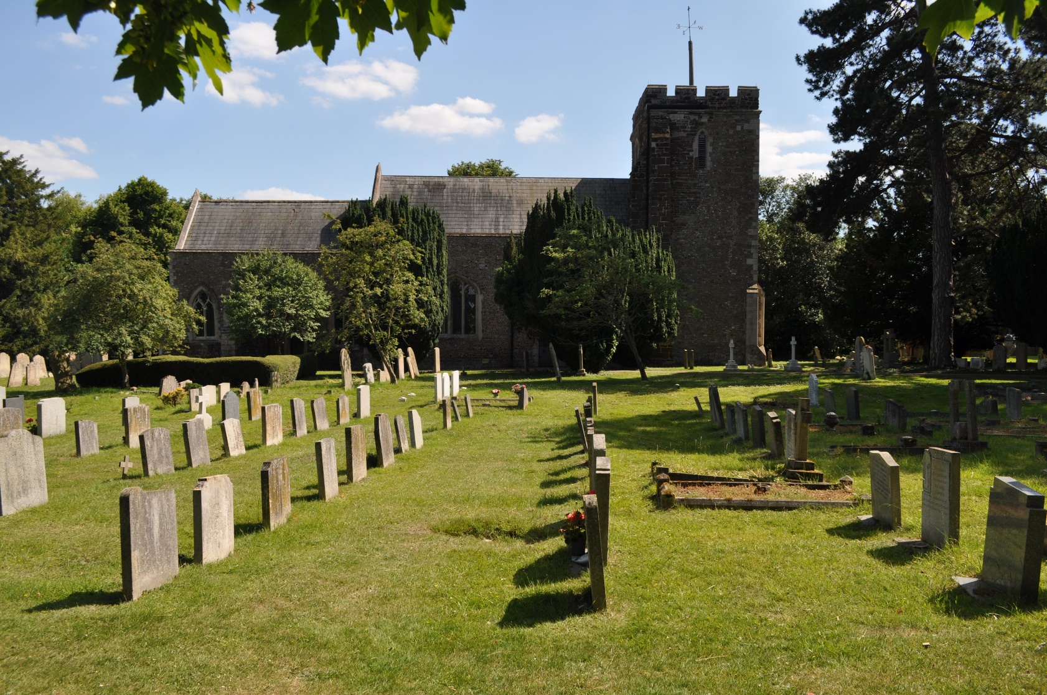
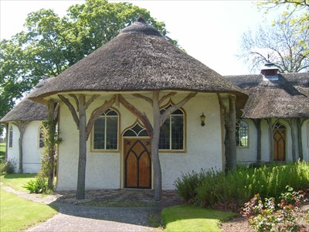
Heritage and the historic environment
Roxton has two Grade II* Listed properties:
• Parish Church of Saint Mary Magdalen
• Congregational Chapel
Roxton village has 18 Grade II Listed properties:
College Farmhouse (High Street)
14, High Street
The Cedars (22, High Street)
28, 30, 32 and 34, High Street
36, High Street
Hope Cottage, 38 High Street
Church Farmhouse (High Street)
46 and 48, High Street
50 and 56, High Street
51, High Street
58, High Street
60, High Street
Barn North West of Numbers 2 and 6 (Ford Lane)
Poplar Farmhouse (Ford Lane)
2 and 6, Ford Lane
Roxton House
Roxton House Lodge
Tempsford Bridge
We have to consider the conservation and preservation of these assets, as they help form the character and heritage of the village.

Slide 13
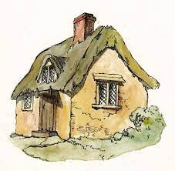
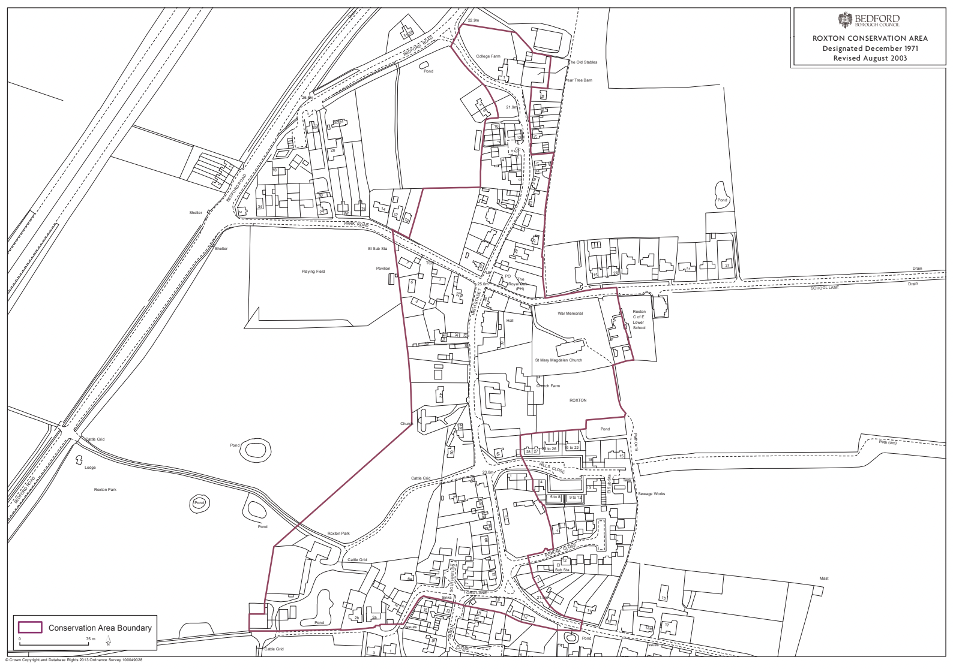
Heritage and the historic environment
Part of Roxton is also a designated Conservation Area. Conservation areas exist to manage and protect the special architectural and historic interest of a place - in other words, the features making it unique.
In conservation areas there are some extra planning controls and considerations which protect the historic and architectural elements making the place special.
In 2003, the area designated as a Conservation Area was expanded to include most of the village.

Slide 14
Key questions 4: Heritage and the historic environment
1. Should more be done to preserve and enhance our heritage sites and buildings?
2. What can be done to help the Grade II listed buildings have a sustainable future?
3. How can we contribute to the preservation and conservation of our listed heritage assets?
4. Are there any other heritage assets you feel are overlooked/ undervalued?
Land use planning takes into account economic, social and environmental dimensions.
5. How could our Plan be used to conserve and enhance the quality of the historic environment to encourage tourism, help to create successful places for businesses to locate and/or attract inward investment?
6. What else do you think about local heritage?
Use this space to write any notes:
……………………………………………………………………
……………………………………………………………………
……………………………………………………………………
……………………………………………………………………

Slide 15
Key questions 5: Employment
There’s limited employment provided in Roxton Parish, but quite a few home-based businesses. There’s also a Post Office, garden centre, cafe, pub (currently closed), B&B and AirBnB-type businesses, and farms. The Local Plan 2040 talks of employment opportunities - but is it in the way you want?
1. Do we need more employment in the Parish?
2. What other local employment do we need, if any?
3. Should the Plan allocate land or premises for new or expanding businesses?
4. Should home working be encouraged more? If so, what extra or better facilities should be promoted to assist with this?
5. Do you run a local business? If so please leave details with us so we can send you a business survey form.
6. What else do you think about this topic?
Use this space to write any notes:
……………………………………………………………………
……………………………………………………………………
……………………………………………………………………

Slide 16
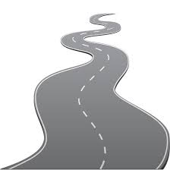
Key questions 6: Getting about
The Plan will cover all land, buildings, roads and footpaths within Roxton Parish Boundary, not just what’s obviously ‘in the village’.
We have bus services to/from Bedford, St Neots & Cambridge, as well as Great Barford’s weekly Ivel Sprinter to Tesco & St Neots. We have a good network of public footpaths, and a planned bridleway. But Roxton isn’t alone in being affected by rising traffic levels. Increases in car ownership means we have more on-street parking as many houses don’t have driveways. We have parking issues in School Lane at key school times and some issues with inconsiderate parking during Village Hall events.
The increased traffic due to the School Lane housing development is ‘temporary’. But long term, with more houses we’ll naturally get more cars, delivery vans, etc. What are your thoughts?
Bedford Road/ School Lane are often used as shortcuts at peak times, and we’ve had problems in the village itself with speeding vehicles.
1. Do you have any practical suggestions for ways traffic/parking in the village could be better managed?
2. What about bus services? Would you use them (or use them more) if they were improved? How could they be improved?
3. Should there be better provision for pedestrians, cyclists, equestrians?
4. What else do you think about this topic?
Use this space to write any notes:
……………………………………………………………………
……………………………………………………………………
……………………………………………………………………

Slide 17
Key questions 7: Amenities
and facilities
Roxton is a designated Rural Service Centre. According to the Local Plan 2030, ‘rural services centres…have fewer facilities and provide a more localised convenience and service role to meet day to day needs of residents and businesses in the rural areas.’
We currently have a Primary School, with playing field and playground, the Parish church, a Congregational chapel, the Village Hall, a Cafe, a Post Office, the Garden Centre & Farm Shop, playing fields, play areas, the Millenium Green open space and a variety of street lighting.
1. Do you think the facilities and amenities the village has are about right for its size?
2. If not, what else do you think should be provided or improved?
3. Do you have any other thoughts on the facilities and amenities we have/could have?
Use this space to write any notes:
……………………………………………………………………
……………………………………………………………………
……………………………………………………………………
……………………………………………………………………
……………………………………………………………………

Slide 18
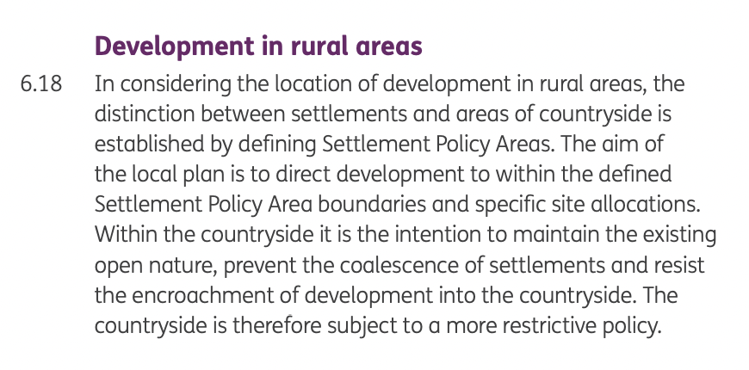
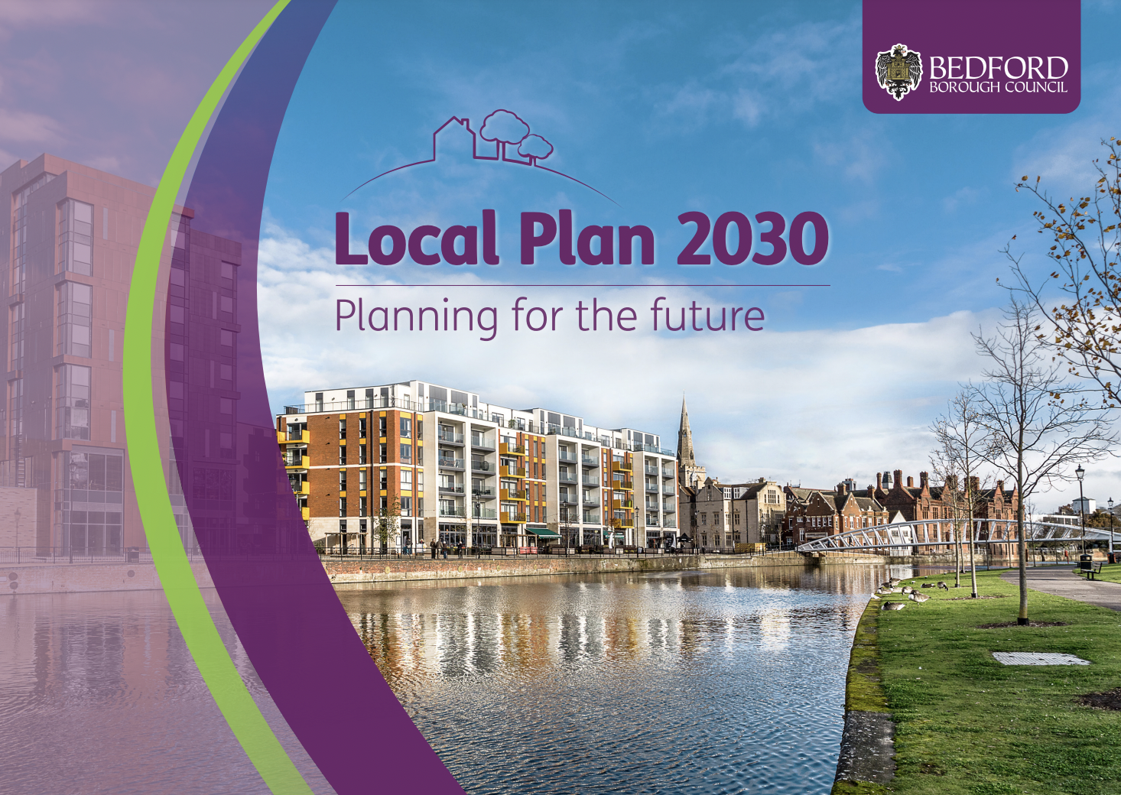
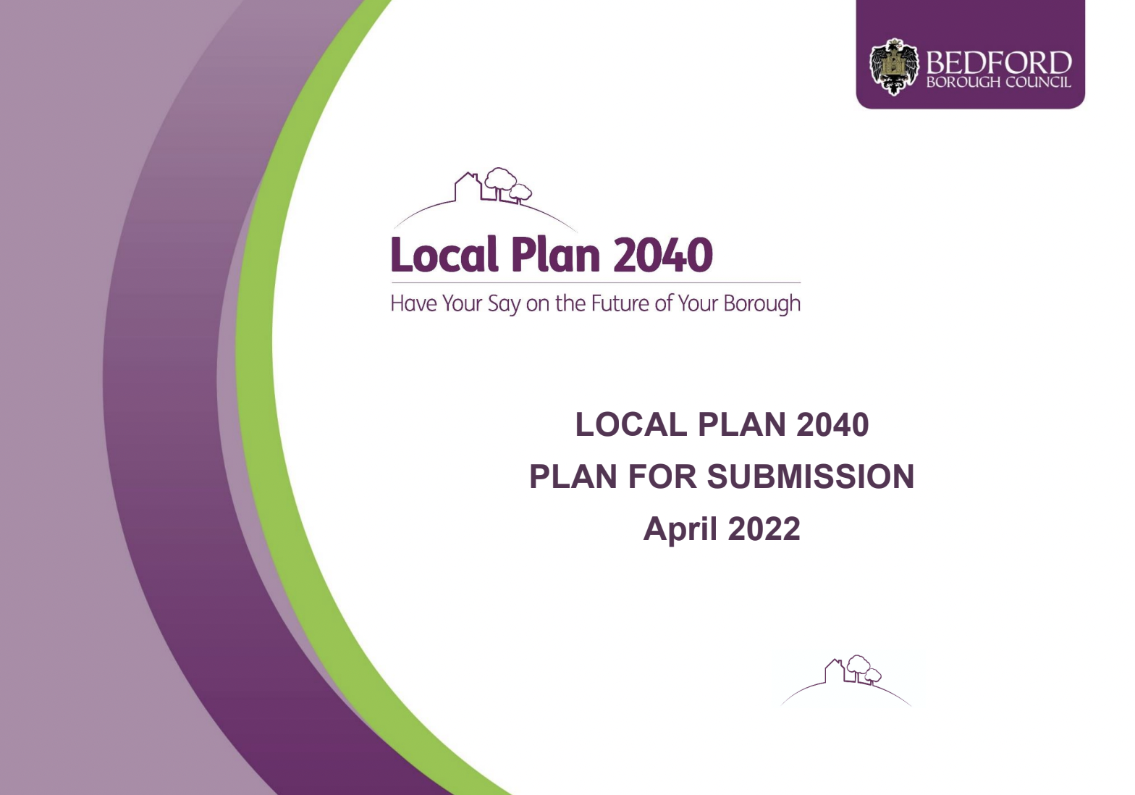
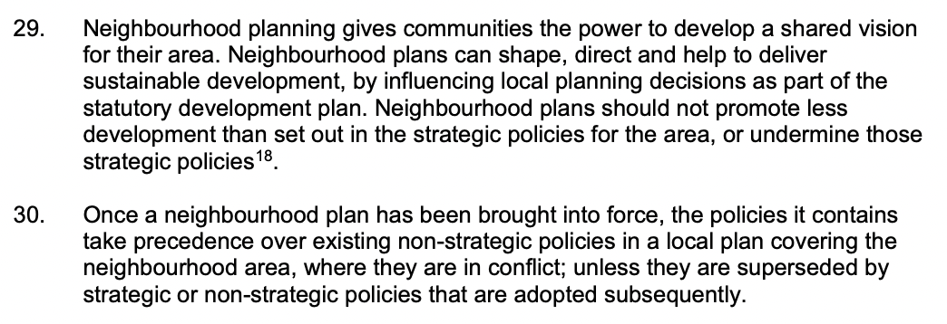
Other useful documents…
These will be available at the launch event at the Village Hall, but you can also search for them online if you’d like to read them.
Local Plan 2030
Local Plan 2040 (Draft)
NPPF (National Planning Policy Framework)

Slide 19
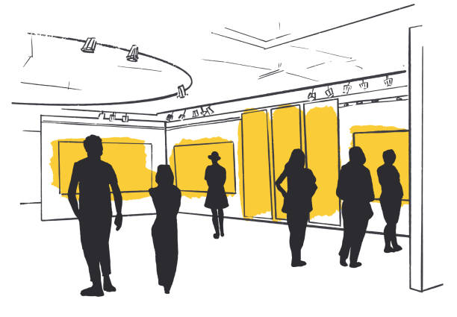
Thank you!
All your comments and suggestions are extremely welcome now and as we continue to draft the Plan.
If you think we’ve missed anything, or if there is an issue of particular importance to you or the community, do please let us know.
The overall vision and objectives for the Plan will be developed to reflect what you’ve said to us, so your comments are important. We’ll be consulting you again as the Plan develops, so there will be more opportunities.
You can help…
Successful Neighbourhood Plans are community led and community prepared. We always need more volunteers. Please think about what could you give to the project in terms of time, experience, skills, resources, enthusiasm?
Please speak to one of the Steering Group.
We look forward to seeing you
at Roxton Village Hall
on 17th or 19th November 2023

Slide 20
Steering Group Contact Details
The Neighbourhood Plan Steering Group is made up of volunteers from the local community:
Julian Chillingworth (Chair)
Chris Evans Kim Gubler Sue Holland
Mike Peebles Claire Rose Brian Vaughan
Two of us also happen to be on Roxton Parish Council BUT we’re completely independent from the Parish Council.
Our primary contact will be via the website:
www.roxtonplan.org.uk
info@roxtonplan.org.uk
(for enquiries about the Village Hall Launch event specifically, feel free to contact Claire on 07931 221239)

